Slide 1

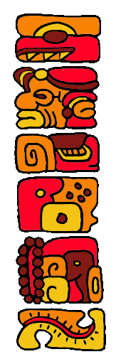
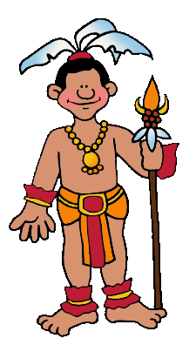
The Hero Twins

Slide 2
The Hero Twins
An Ancient Maya Indian Story
The ancient Maya Indians lived in rainforest of Central America.
Like all people everywhere, the Mayas loved stories. One of their favorite stories was The Legend of the Hero Twins.
The story went something
like this …

Slide 3
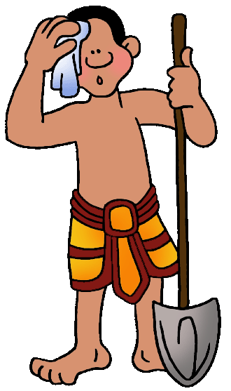
The Hero Twins
Once upon a time, a long time ago, there lived two brothers.
The brothers tried very hard to be good gardeners. But even the rabbit that rooted in their garden for food each day knew they were not very good at gardening.
What they were good at, great at, absolutely excellent at, were ballgames.

Slide 4
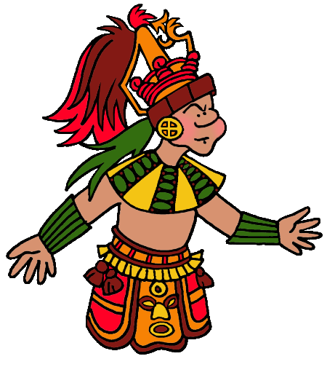
The Hero Twins
Onlookers cheered so loudly whenever the boys played ball that the noise attracted the attention of the Lords of Death.
The Lords of Death lived in the Underworld. They liked to trick people into dying.
They especially liked tricking people who were bothering them, and the boys were bothering them. They were far too noisy!

Slide 5
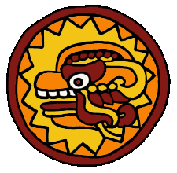
The Hero Twins
The Lords of Death sent an invitation to the brothers, inviting them to play a ballgame in the Underworld.
The boys knew it was a trick. But what could they do? There was no way to ignore a summons from the Lords of Death.
They prepared as best they could, and set out for the Underworld.

Slide 6
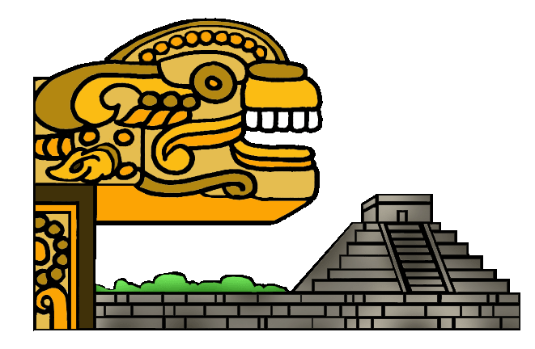
The Hero Twins
They made it safely across the river of spikes.
They made it safely across the river of blood.
They made it safely across the river of pus.
They arrived at the house of the Lords of Death.

Slide 7
The Hero Twins
There, a Lord waited for them to say hello. It was a trick. That Lord was only a wood statue.
When the boys said hello to the wood statue, the real Lords rushed out from where they had been hiding. They shook their heads in pretended shock.
"Do you think our heads are filled with wood?" one cried. The brothers had failed a test.

Slide 8
The Hero Twins
"Now wait," interrupted one of the real Lords. "They did cross all three rivers safely."
"Hum," said one of the other Lords thoughtfully. "Hardly anyone ever does that! That needs to be taken into consideration."
"Have a seat while we think about what to do with you," a third Lord nodded to the brothers.

Slide 9
The Hero Twins
Feeling hopeful that perhaps they would not be killed after all, the brothers sat down on a bench. The bench was burning hot.
The boys leaped up, but it was too late. They had failed another test.
They were challenged to more tests.

Slide 10
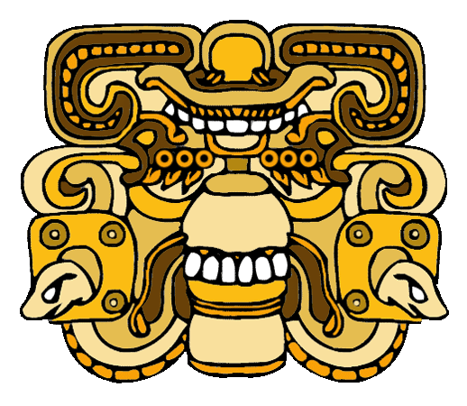
The Hero Twins
They were sent to the Razor House. Sharp blades were supposed to cut them to ribbons. They escaped as a rat would, by crawling under the blades.
They were sent to the Jaguar House. They escaped by feeding the Jaguars the bones they had brought along, just in case.

Slide 11
The Hero Twins
The twins knew there would be test after test, until finally they died.
When a Lord said, "Let us see if you can jump over these ovens", the boys jumped into the oven instead and died.
The Lords of Death tossed the boys’ ashes into a river. The life giving water cooled the ashes.

Slide 12
The Hero Twins
The twins soon discovered they were still alive!
First the Hero Twins came back as catfish. Then they turned back into their normal selves.
“It would appear we have picked up some magic from somewhere!” gasped a twin.

Slide 13
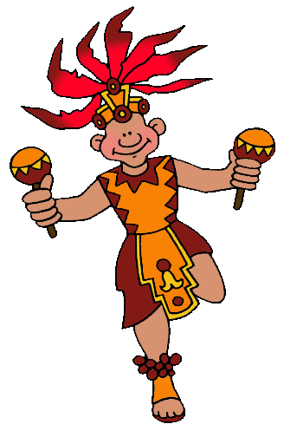
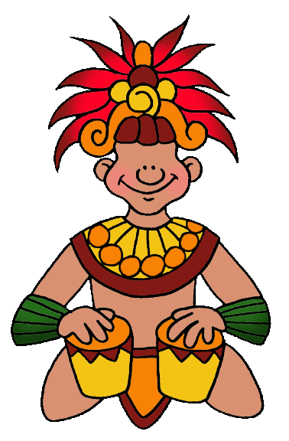
The Hero Twins
Quite by accident, they discovered they had other magical powers.
They could cut themselves up and put themselves back together again. They could burn a house down and then restore it to its original shape.
The Hero Twins traveled from town to town, singing and dancing and performing fabulous tricks for a living.

Slide 14
The Hero Twins
The Lords of Death heard of their amazing act. They sent the twins an invitation to the Underworld, not knowing that they were inviting the very twins they had killed so recently.
When the twins performed their act, the Lords were delighted.
"Do me next," one Lord cried. "Chop me up and put me back together again!"

Slide 15

The Hero Twins
The twins were delighted to chop up the Lord. Only, they did not put the Lord back together again.
The other Lords knew they had been defeated.
Rather than risk losing any more Lords, they sent the twins back to earth.

Slide 16

The Hero Twins
The gods of the heavens, who had provided a great deal of the magic although no one knew that except the gods of the heavens, honored the courage and cleverness of the Hero Twins by bringing them up to the sky.
One twin became the sun. The other became the moon.
And their children became the rulers of the earth!

Slide 17
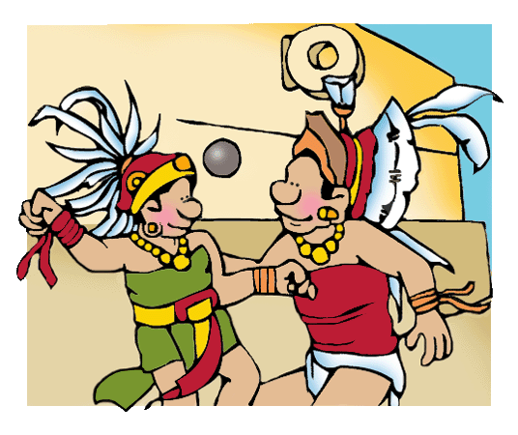
The Hero Twins
The children of the earth build ball courts in every town in the world in honor of their ancestors, the Hero Twins.

Slide 18
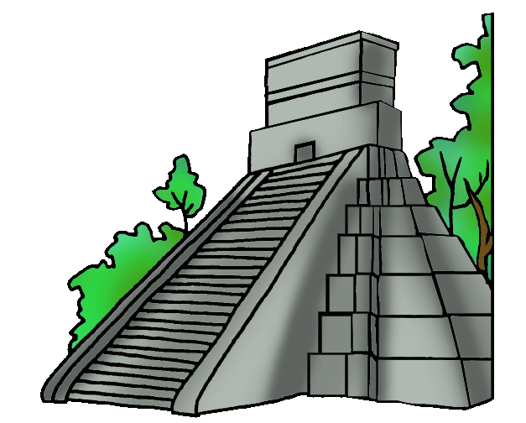
To Learn More
Go Here:
Ancient Mayas for Kids

Slide 19
Clip Art/Templates
Created by a professional and published artist, Phillip Martin:
Free Maya Clip Art
Free Templates & How to Use Them

Slide 20
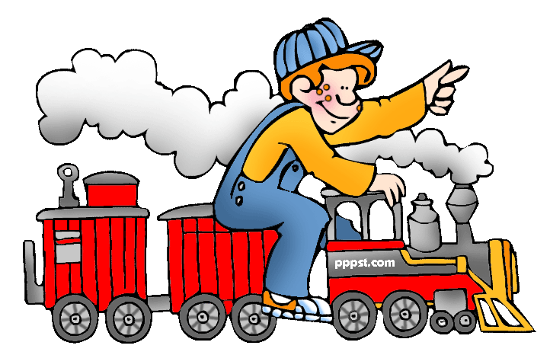
Explore …
PPPST.COM

